Slide 1
COMPREHENSIVE DIGITAL
MARKETING FOR
PTRON

Slide 2

PRESENTING BY
Government College for Women A’
Srikakulam Ambedkar University Project for PTRON
Team ID:
(LTVIP2024TMID10327)
Team lead :
Team Members:
B.Bhavani
B.Rama
B.Jeevitha
CH.Urmila
CH. Lavanya kumari

Slide 3
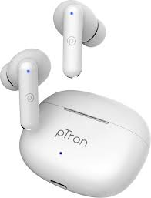
PTRON
Ptron is a tech brand known for its wide range of electronic accessories and gadgets. From headphones and earphones to power banks and chargers, Ptron offers products designed to enhance and complement the digital lifestyle.
With a focus on innovation, quality, and affordability, Ptron strives to provide cutting-edge solutions that meet the needs of modern consumers.
Whether you're looking for stylish headphones for music on the go or reliable power banks to keep your devices charged, Ptron aims to deliver reliable products that enhance your digital experience.

Slide 4
Part 1 : Brand study,Competitor
Analysis & Buyers/Audience
Persona

Slide 5
Research of Brand Identity
Mission/Values:
For a perceptron (ptron), mission values might include accuracy, efficiency, adaptability, and simplicity in solving binary classification Tasks.
Quality: Commitment to delivering earbuds crafted with premium materials and cutting-edge technology to ensure durability and superior sound performance.
Innovation: Continuously strive to innovate and improve our products, incorporating the latest advancements in audio technology to meet the evolving needs of our customers.
Affordability: Ensuring accessibility by offering competitively priced earbuds without compromising on quality or features.
USP :
The Unique Selling Proposition (USP) for Ptron earbuds could be:
"Ptron earbuds offer an unbeatable combination of premium sound quality, ergonomic design, and affordability, providing users with a truly immersive audio experience that enhances their lifestyle without breaking the bank."

Slide 6
Analyzing of Brand Messaging:
Tag line for ptron: "Innovate. Elevate. Empower”.
Target Audience: Who is the brand trying to reach? Understanding the demographics, interests, and needs of the target audience is crucial.
Brand Values: What does ptron stand for? What values does the brand want to communicate to its audience?
Messaging: What is the core message ptron is conveying? Is it about quality, affordability, innovation, or something else?
Consistency: How consistent is ptron in its messaging across different platforms and communication channels?
Effectiveness: Is the brand message resonating with its target audience? Are they able to understand and connect with it?
Clarity and Consistency: Evaluate the clarity and consistency of Ptron's brand message across various touchpoints such as its website, social media channels, advertising campaigns, and product packaging.

Slide 7
Brand Tone:
Ptron speaks the language of innovation and accessibility. We're all about cutting-edge technology made simple, empowering everyone to experience the best without complications. Our tone is friendly, confident, and approachable, just like your favorite tech-savvy friend who's always there to help you navigate the digital world. We're passionate about delivering quality products that enhance your life, and we're excited to be on this journey with you.
KPI’s of Ptron:
Sales Revenue: How much money Ptron makes from selling its products.
Market Share: How much of the market Ptron controls compared to its competitors.
Customer Satisfaction: How happy customers are with Ptron's products.
Product Return Rate: How many products are returned because customers aren't satisfied.
Brand Awareness: How many people know about Ptron and its products.
Customer Acquisition Cost (CAC): How much money Ptron spends to get a new customer.
Customer Lifetime Value (CLV): How valuable a customer is to Ptron over time.
Inventory Turnover: How quickly Ptron's products are sold.
Product Performance Metrics: How well Ptron's products are working and if they have any issues.
Net Promoter Score (NPS): How likely customers are to recommend Ptron to others.

Slide 8

Smart Goals:
Increase Sales Volume: Achieve a 25% increase in monthly sales volume for Ptron products by the end of the fiscal year.
Launch Two New Product Lines: Introduce two new product lines catering to different market segments within the next six months, each projected to contribute at least 15% to overall revenue by the end of the year.
Improve Customer Retention: Implement a customer loyalty program aimed at increasing repeat purchases by 20% within the next quarter.
Enhance Product Quality: Reduce product defects by 30% within the next three months
through rigorous quality control measures in manufacturing and product testing
processes.
Expand Global Presence: Enter two new international markets within the next year, establishing distribution channels and achieving a market penetration rate of 10% in each new market within the first six months.
Increase Brand Awareness: Launch a targeted marketing campaign focused on increasing brand awareness, aiming to achieve a 15% increase in brand recognition among the target audience within six months.

Slide 9
Buyer’s/Audience persona:
Name: Sarah
Demographics:Age:25-35
Gender: Female
Occupation: Marketing Manager
Income Level: Middle to Upper-middle class
Needs and Goals:
Seeks quality, convenience, style, tech features, and value for money.
Behavior: Research-oriented, active on social media, early adopter, brand loyal.
convenience: Given her busy schedule,sarah looks for product that offer convenience and ease of use.She
appreciates products that seamlessly integrate into her daily routine
Style and Design: Being fashion-conscious, Sarah prefers products that not only perform well but also look Stylish.
Tech Features: As someone who enjoys technology, Sarah is attracted to products with advanced features and
capabilities. She's always interested in trying out the latest gadgets and innovation
Value for Money: While Sarah is willing to invest in quality products, she also expected good value for her money.
Preferred Ptron Products:
Wireless earphones, power banks, Bluetooth speakers. Ptron's wireless earphones, offering her freedom of movement
during her busy day. She relies on Ptron's power banks to keep her devices charged, ensuring she stays connected.
Additionally, Ptron's Bluetooth speakers enhance her social gatherings with high-quality sound and sleek design,
reflecting her tech-forward tastes.

Slide 10
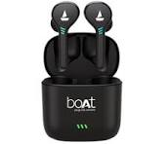
Competitor Analysis
Competitor1: boAt
Usp:
boAt has established itself as a brand known for its trendy and affordable audio products, especially headphones, earphones, and speakers.Its USP lies in offering stylish and feature-rich products at competitive prices, targeting the youth and those looking for budget-friendly yet quality audio solutions.The emphasis on combining style with substance, such as trendy designs, vibrant colors, and good sound quality, sets boAt apart from its competitors.
Online communication:
Ptron's online communication strategy focuses on engaging its audience across social media platforms like Instagram, Facebook, Twitter, and LinkedIn. Through visually appealing content ,interactive features, and collaborations with influencers, Ptron aims to amplify its brand research and connect with new customers. Collaborating with relevant influencers and content creators can extend its reach and credibility, while user-generated content can foster a sense of community and trust.

Slide 11
SWOT Analysis:
Strengths:
Brand Recognition: boAt has established itself as a leading brand in the audio accessories market, known for its trendy designs and quality products.
Product Diversity: The company offers a wide range of audio products including headphones, earphones, speakers, and wearables, catering to diverse consumer preferences.
Weaknesses:
Brand Perception: While boAt has gained popularity among younger consumers, some may perceive it as a budget brand rather than a premium audio solution provider, affecting its positioning in the market.
Opportunities:
Emerging Markets: Expanding into emerging markets and untapped regions presents opportunities for boAt to further grow its customer base and increase market share.
Product Innovation: Investing in research and development to introduce innovative features and technologies in its products can help boAt stay ahead of competitors and capture new market segments.
Threats:
Rapid Technological Changes: Rapid advancements in technology and evolving consumer preferences pose a threat to boAt's products becoming obsolete if it fails to keep up with the pace of innovation.

Slide 12
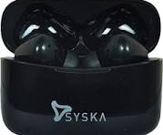
Competitor 2: Syska
USP:
Syska's USP revolves around its innovative approach to providing high-quality electronic accessories that seamlessly combine cutting-edge technology with stylish design, ensuring both functionality and aesthetic appeal for consumers. Each Syksa product is crafted with attention to detail, ensuring reliability, durability, and performance, all while maintaining an affordable price point. With a focus on user-centric design and cutting-edge technology, Syksa consistently provides value to its customers, making it a trusted choice for tech enthusiasts worldwide.
Online communication:
Syska's online communication strategy involves active engagement on social media platforms, prompt response to customer inquiries, collaborations with influencers, provision of informative content, targeted email marketing, and showcasing positive user reviews to enhance brand presence, drive sales, and foster customer relationships. By leveraging these online communication strategies effectively, Syksa can continue to strengthen its brand presence, connect with its audience, and drive growth in the competitive tech accessories market.

Slide 13
SWOT Analysis:
Strengths:
Product Innovation: Syska is known for its innovative electronic accessories, often incorporating
the latest technology trends into its products.
Weaknesses:
Competition: In a crowded market, Syska faces competition from both established brands and
new entrants, making it challenging to stand out.
Customer Service: Some customers have reported issues with Syska's customer service, including
delayed responses and difficulty with product returns or exchanges.
Opportunities:
Market Expansion: Syska can explore opportunities to expand its market presence, both
domestically and internationally, by tapping into emerging markets and distribution channels.
Threats:
Rapid Technological Changes: The fast pace of technological advancements poses a threat to
Syska, as it must continuously innovate to keep up with changing consumer preferences and
industry trends.

Slide 14

Competitor 3: MI (Xiaomi)
USP:
Xiaomi's USP lies in its commitment to providing high-quality technology products at affordable prices, making advanced technology accessible to a wider audience. By offering a wide range of products spanning smartphones, smart home devices, wearables, and more, Xiaomi emphasizes innovation, performance, and value for money.
Online communication:
Xiaomi's online communication strategy is multifaceted, encompassing various channels and tactics to engage with its audience effectively. One key aspect is its active social media presence across platforms like Twitter, Facebook, and Instagram. Through these channels, Xiaomi shares regular updates about its products, promotions, and events, keeping followers informed and engaged. Additionally, Xiaomi nurtures a vibrant online community through its Mi Community platform, where users can interact, share experiences, and provide feedback, fostering a sense of belonging and brand loyalty.

Slide 15
SWOT Analysis:
Strengths:
Innovative Products: Xiaomi is known for its innovative and technologically advanced products, ranging from
smartphones to smart home devices.
Strong Brand Image: Xiaomi has built a strong brand image globally, known for offering high-quality products at
affordable prices.
Weaknesses:
Patent Issues: Xiaomi has faced patent infringement issues in some markets, leading to legal challenges and potential
setbacks.
Dependency on China Market: Xiaomi's heavy reliance on the Chinese market for revenue poses a risk, as changes in
regulations or market conditions could impact its financial performance.
Opportunities:
Expansion into New Markets: Xiaomi has opportunities to expand its presence in emerging markets and explore new
product categories to diversify its revenue streams.
Threats:
Regulatory Challenges: Regulatory changes in key markets, particularly related to trade tariffs or data privacy
regulations, could pose challenges for Xiaomi's global expansion
plans.

Slide 16
Part-2 : SEO & Keyword Research

Slide 17
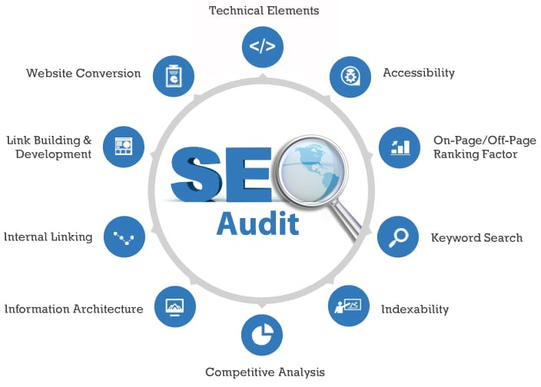
SEO and KEYWORD RESEARCH
SEO Audit:
Evaluate the relevance, quality, and freshness of existing content.
Identify content gaps and opportunities for creating new content.
Ensure content aligns with target keywords and addresses the needs and
I interests of the target audience.
Keyword Research: Utilize keyword research tools such as Google Keyword Planner, SEMrush, or Ahrefs to find keywords relevant to Ptron's products. Look for keywords with high search volume and low to medium competition. Also, consider long-tail keywords that are more specific and have less competition.
Competitor Analysis: Analyze competitors' websites to see what keywords they are targeting. This can provide insights into potential keywords to target and areas where Ptron can differentiate itself.
On-Page Optimization: Incorporate the selected keywords strategically into Ptron's website content, including page titles, meta descriptions, headings, and body copy. However, ensure that keywords are used naturally and don't compromise the readability of the content.

Slide 18
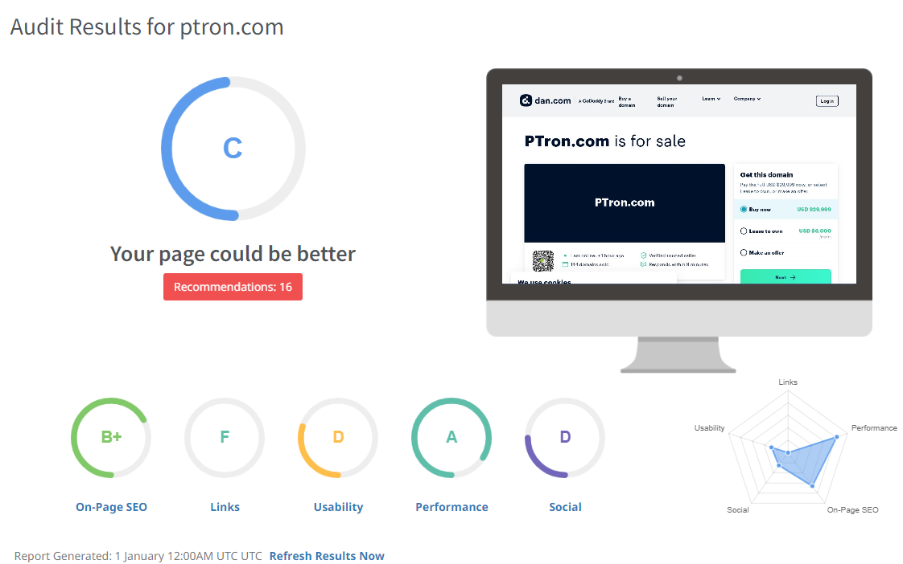
Seo Audit
\

Slide 19
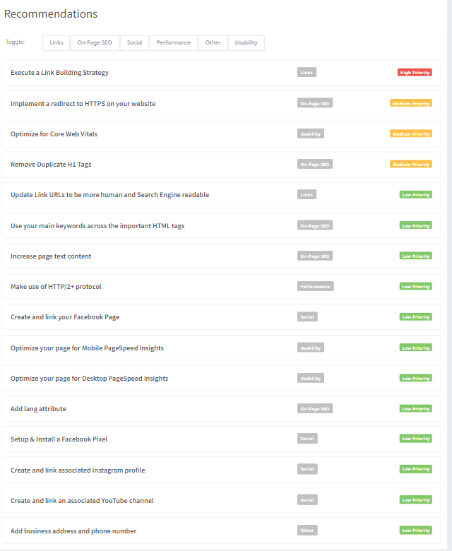
Seo Audit

Slide 20
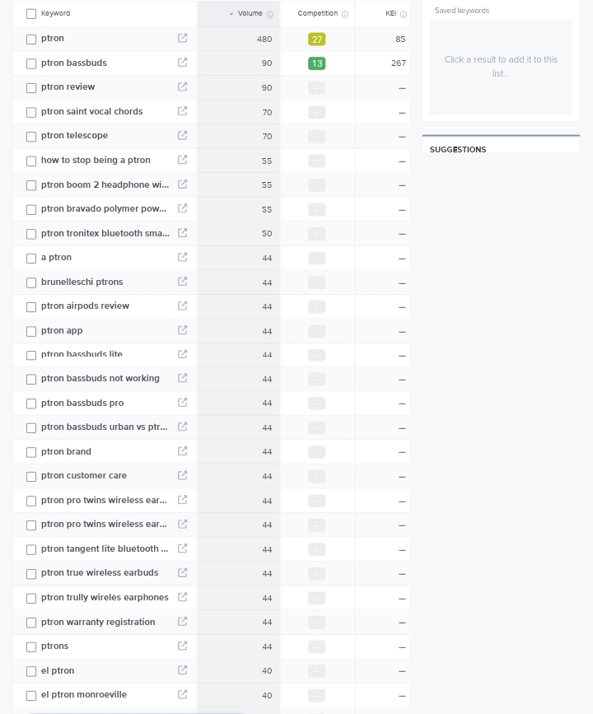
Keyword Research

Slide 21
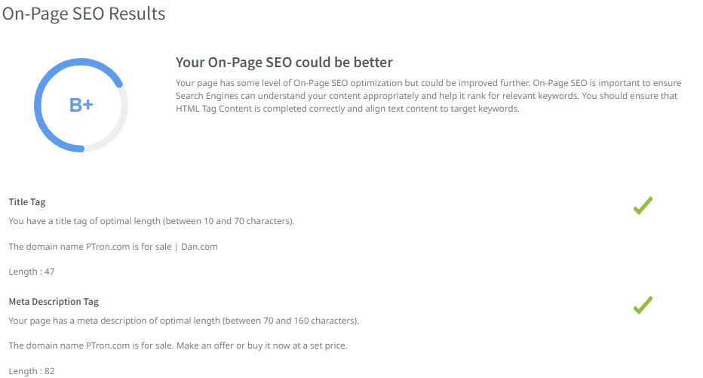
On Page Optimization

Slide 22
On Page Optimization(Content Optimization)
Keyword Placement: Ensure relevant keywords (e.g., "Ptron gadgets," "tech accessories") are strategically placed in titles, headers, and throughout the content.
High-Quality Content: Create engaging, informative content that resonates with the target audience and showcases Ptron's unique value proposition.
Keyword Optimization: Strategically place relevant keywords throughout the website's content,
including titles, headings, product descriptions, and meta tags, to improve search engine
visibility.
Quality Content Creation: Develop high-quality, informative content that addresses the needs and interests of the target audience while incorporating relevant keywords naturally.
Meta Tags Optimization: Optimize meta titles and descriptions with primary keywords to improve click-through rates and enhance search engine ranking.
Image Optimization: Ensure images are optimized with descriptive filenames and alt text containing relevant keywords to improve accessibility and visibility in image search results.
Mobile Optimization: Ensure the website is optimized for mobile devices, providing a seamless user experience across different screen sizes and improving mobile search rankings.
Internal Linking: Incorporate internal links to relevant pages within the Ptron website to improve navigation and encourage users to explore more content.

Slide 23
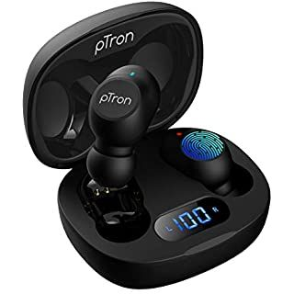
Keyword Insights:
Wireless Earbuds:Investigate consumer interest and trends surrounding ptron’s wireless earbuds,including features like battery life,sound quality and design.
Budget Tech Accessories:Explore the market demand for affordable tech accessories offered by Ptron,such as power banks,charges and cables focusing on pricing competitiveness and value for money.
Customer Satisfaction: Analyze customer reviews and feedback to gauge satisfaction levels with Ptron products, identifying common praise and areas for improvement.
Market Expansion: Assess Ptron's strategies for expanding its market reach, including international expansion, partnerships with online retailers, and diversification of product offerings.
Brand Perception: Assessing how consumers perceive the Ptron brand in terms of reliability, quality, and value for money.
Customer Reviews: Examining customer feedback on Ptron products to identify strengths, weaknesses, and areas for improvement.

Slide 24
Part-3: Content Idea and
Marketing Strategies

Slide 25
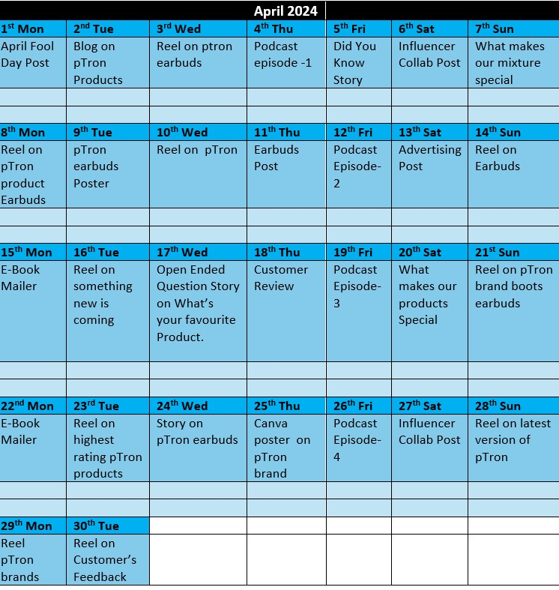
Content Calender

Slide 26
Content ideas:
Product Showcase & Innovation: Highlight Ptron's products through engaging showcases, emphasizing innovation, unique features, and benefits to attract and inform potential customers.
Customer Engagement & Community Building: Foster a sense of community and engagement by sharing customer success stories, organizing interactive campaigns, and encouraging user-generated content, which can enhance brand loyalty and advocacy.
Education & Support: Provide valuable educational resources such as tutorials, guides, and FAQs to help users maximize the utility of Ptron products, while also offering comprehensive customer support to ensure a positive user experience.
Content Strategies:
Educational Content on Product Usage: Ptron likely offers a range of electronic products such as headphones, earphones, power banks, and more. Creating educational content that demonstrates how to use these products effectively can be highly valuable.
User-Generated Content Campaigns: Encouraging customers to share their experiences with Ptron products through user-generated content campaigns can be a powerful strategy.
Lifestyle Content Integration: Incorporate Ptron products into lifestyle content such as fitness routines, travel vlogs, and productivity tips, showcasing how they enhance various aspects of consumers' lives.

Slide 27
Part-4: Content Creation and Curation

Slide 28
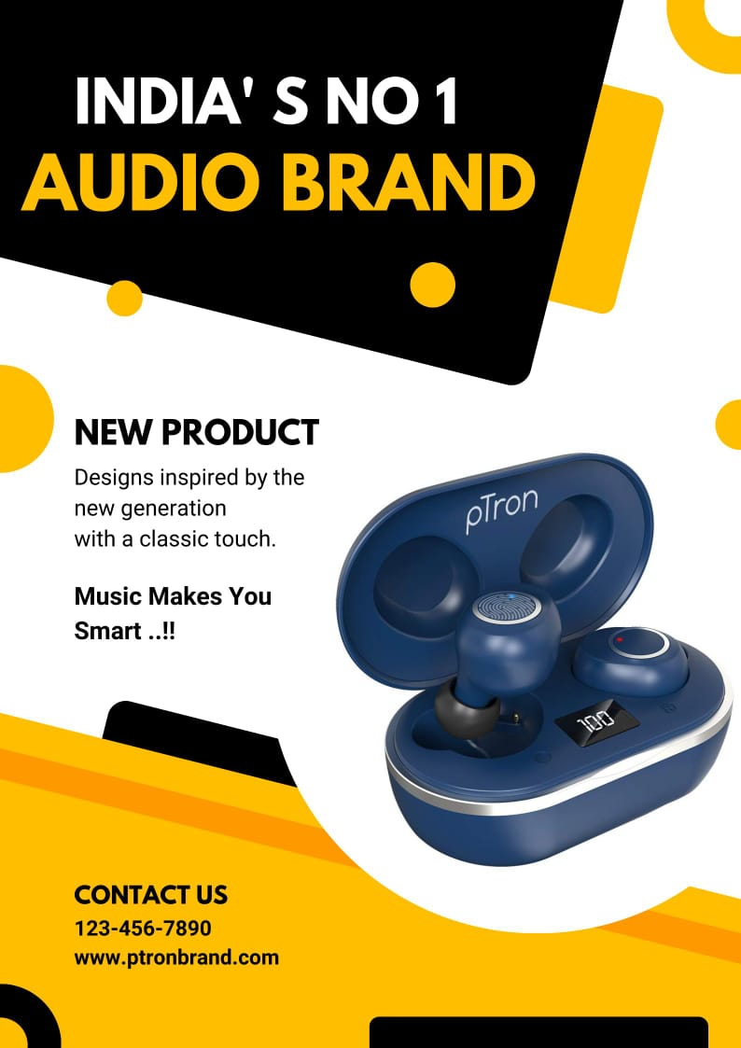
Poster Creation:
Post link:
https://www.instagram.com/p/C6F-fvzrMtN/?igsh=MW5tZno3b3JkNXpleA==
PTRON:
“Innovate. Elevate. Empower”

Slide 29
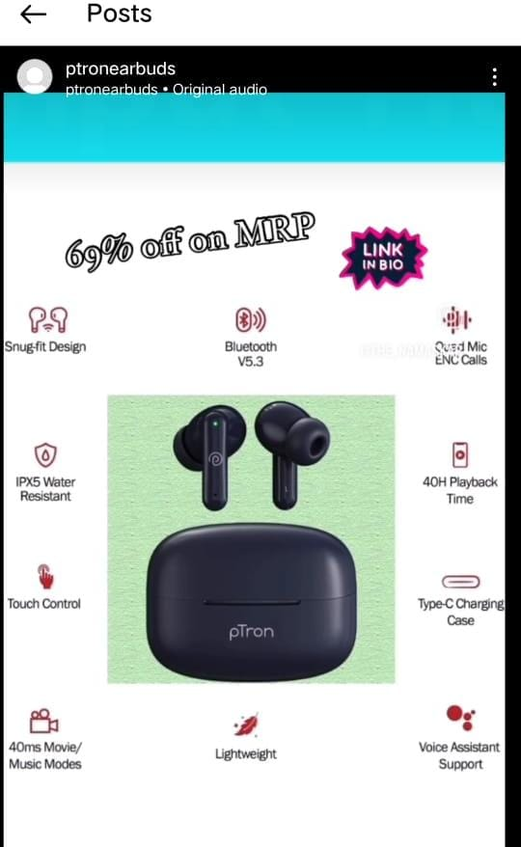
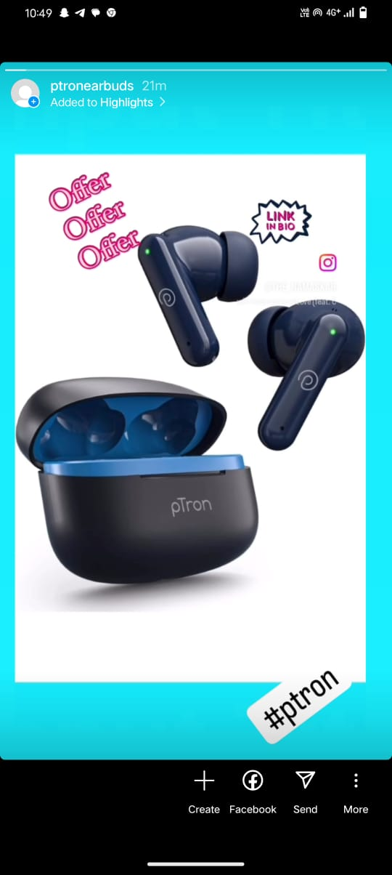
Instagram Story:
Link for Insta reel:
https://www.instagram.com/reel/C6F2xmHrKuA/?igsh=dWdheWNra3BsM2th
Link for insta story:
https://www.instagram.com/s/aGlnaGxpZ2h0OjE4MDIxNTA3NjEwOTY1NjY3?story_media_id=3352325195664695910_66317801753&igsh=aTkwdXNmaWxzYndw

Slide 30
THANK YOU

